Slide 1


Slide 2
Cooling of mine Air by chilled water system

Slide 3
Cooling of mine Air by chilled water system
INTRODUCTION:
As the mines are extended to depth and expanded laterally, the challenge of maintaining adequate ambient temperature and conditions for underground workers and machinery deployed will sorely test the skills of mine-ventilation engineers.
As the depth is increasing, ventilation alone will not suffice the requirements so the cooling of mine air is imperative.
There are various methods of cooling the mine air, one of which is cooling by chilled water system. This system is mostly applied in south africa , USA.

Slide 4
potential sources of heat in mines
Surface air entering the mine
Heat flow from wall rock
Heat due to auto-compression in shafts
Ground water
Machinery and lights, locomotives
Human metabolism
Oxidation
Blasting

Slide 5
Processes or systems utilized to produce chilled water:-
Refrigeration
Evaporative cooling
Refrigeration:-
The mechanical process of absorption of heat from one location and its transfer to the rejection at another place is termed refrigeration. The working medium or refrigerant alternates between the liquid and vapor phases. Hence such processes are called change of state or vapor cycle.
Basic vapor cycle:
A refrigeration system consists of a cycle of four basic processes circulating a refrigerant, the heat transfer medium .The purpose of the refrigerant is to absorb heat from a “source”(evaporator) and discharge it through a “sink”(condenser). Some type of vapor fan is located between the source and sink so that the energy absorbed by the refrigerant in the evaporation may be transferred to the condenser for discharge ;it takes the form of a compressor.

Slide 6
The final component of a vapor refrigeration system is an expansion valve, used to control flow rate and permit cooling of the refrigerant in it’s return to the evaporator.
A vapor refrigeration cycle in schematic is represented by following block diagram-

Slide 7
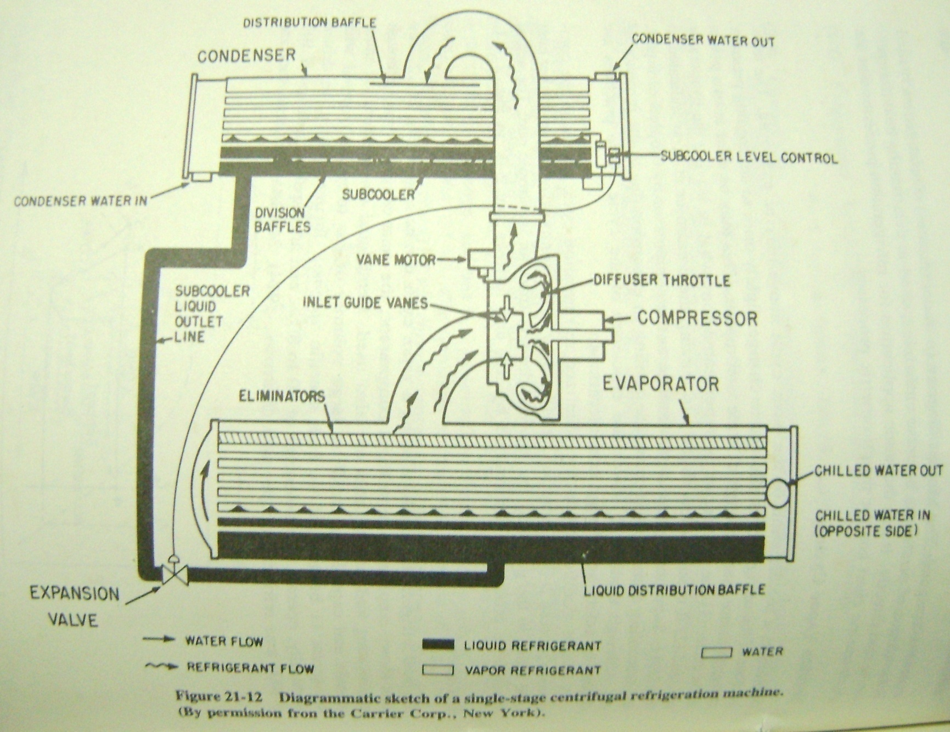

Slide 8
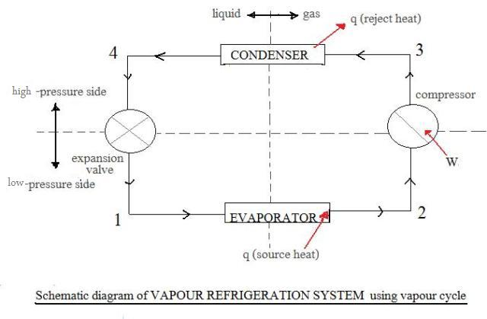
Vapour Compression Refrigeration System

Slide 9
1) Evaporator: Refrigerant evaporates , changing state from predominately liquid to gas and absorbing heat from substance to be cooled(water), with no change in temperature.
2) Compressor: In the vapor state , refrigerant flows to compressor , where work is done in compressing it.
3) Condenser : Vapor condensed to liquid again , giving up heat without a temperature change.
4) Expansion valve: Temperature and pressure of liquid drops during expansion as refrigerant completes cycle.
1-2 Evaporation is isothermal process
2-3 Compression is isentropic process
3-4 Condensation is isothermal process
4-5 Expansion is an adiabatic process
Notes:
Adiabatic process – no heat is transferred to or from the liquid.
Isentropic process – No change in entropy of the system Entropy=microscopic disorder within the system.

Slide 10
To ensure the complete change of state the temperature of refrigerant is allowed to change slightly prior to undergoing pressure change.
This is done at two point of cycle
(A) the refrigerant is superheated somewhat in leaving at evaporator at 2.
(B) It is sub-cooled slightly in leaving the condenser at 4.
Superheating prevents damage to the compressor by droplets of liquid and sub-cooling eliminates incomplete cooling in expansion due to presence of gas.

Slide 11
Refrigerants
A variety of fluids ,both liquid and gases ,with good heat transfer properties are used as refrigerants. Although ammonia is cheap in cost but can mostly be used in surface plants where leaks are not hazardous. For underground installations, the feron(CFC compounds) refrigerants are most commonly used.

Slide 12
Q. A new section of an operating mine is opened 600ft from intake shaft, at the end of the drift there are four stopes whose air requirement is 10000cfm(4.7cubic meter per second).
We have to calculate the cooling load of a cooling plant which will supply chilled water at 40 °F(4.4 °C) and discharged at a temp. of 70 °F(21 °C).
Ans >>
Given : Entering air temp. = 75 °F (24 °C)dry bulb and 70 °F(21°C) wet bulb
pressure = 30 inch of Hg(102KPa)
Heat will be added to the air entering the shaft by the wall rocks of the drift, Mechanical heat gain through fan(From intake shaft upto cooling plant).
Assuming no heat addition in pipe lines, any other form of heat addition due to ground water inflow ,evaporation fluctuation and changing nature of electromechanical and other heat sources.
The temperature increased due to wall rock in drift causes 2.2 °F and 8.6 °F in wet bulb and dry bulb temp. and the fan adds 2 °F and 4 °F respectively in wet bulb temp. and dry bulb temp.
Notes:
1 ft = 0.3048 m

Slide 13
Thus the temperature of air at the cooler is
Dry bulb temp. = 88 °F
Wet bulb temp. = 74 °F
Air temp. Entering the stope(Conditioned Air) = (60 °F) both dry bulb and
Wet bulb.
Enthalpy = 36.37Btu/lb

Slide 14
Cooling Plant Capacity
Entering air data :
Q = 40,000 cfm t_{d} = 88º F t_{w} = 74º F
P_{b} = 30 in. Hg w = 0.0719 lb/ft³ h = 47.36 Btu/lb
Conditioned air data :
t_{d} = t_{w} = 60º F h = 36.37 Btu/lb
The cooling capacity of Plant can be calculated :
Cooling load q = 60 . w. Q . ∆h
= 60 (0.0719)(40000)(47.36 – 36.37)
= 1,896,400 Btu/h (556 kW)
Required volume flow rate of chilled water , supplied at 40⁰ F & warmed to 70º C
Q_{w} = 1,896,400 /(1)(70-40)(8.345)(60) = 126 gpm (8.0 L/s)
Notes:
1 W = 3.41 Btu , 1 gallon (US)= 4.54609 liters. 1 lb= 0.45359 Kg.

Slide 15
COOLING TOWER
The principal means of heat transfer involved in cooling towers is Evaporative cooling.
Evaporation of a small portion of the water being sprayed or percolated in the air of the tower removes sensible heat from the remaining water. The increasing heat content of the air is of no consequence , since the air is exhausted to the atmosphere on the surface or to the up cast shaft underground . Depending on the relative temperatures of air and water , sensible cooling of the water and latent heating plus sensible heating or cooling of the air occurs.

Slide 16
.
COOING TOWERS ARE USED TO COOL THE HEATED CONDENSER WATER FOR REUSE IN A CYCLIC SYSTEM. IN UNDERGROUND MINES, COOLING TOWERS HAVE TO BE PROPERLY LOCATED AND DESIGNED DEPENDING ON THE AMOUNT OF HEAT TO BE EXTRACTED, AND THE TEMPERATURE, HUMIDITY AND FLOW RATE OF AIR AVAILABLE FOR COOLING.
Spray chambers/towers are used instead of cooling towers in some u/g plants. Most spray towers are located in parts of shafts or winzes where the condenser water is sprayed at the top and works its way down through sets of screens, with the cooling air flowing upwards under the ventilating pressure of the mine.

Slide 17
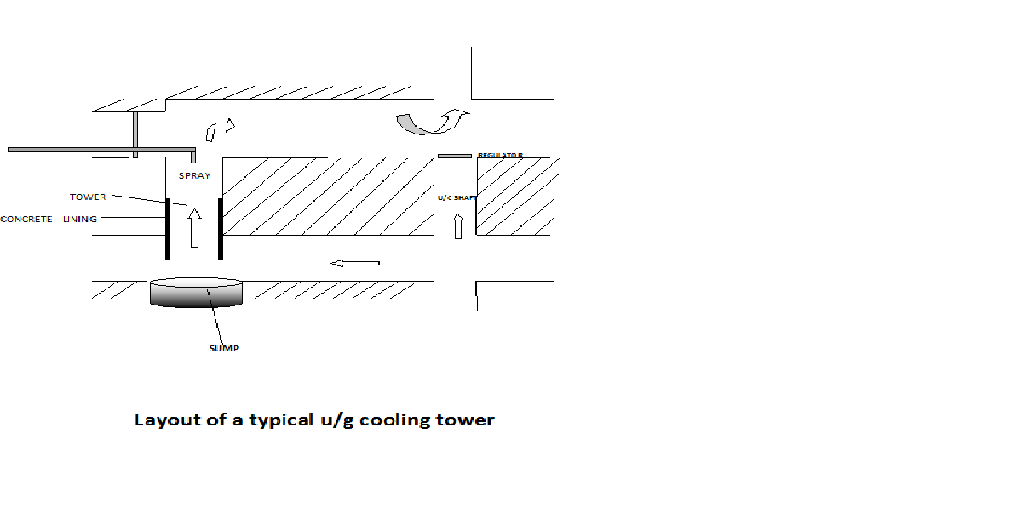
Layout of typical u/g cooling tower

Slide 18
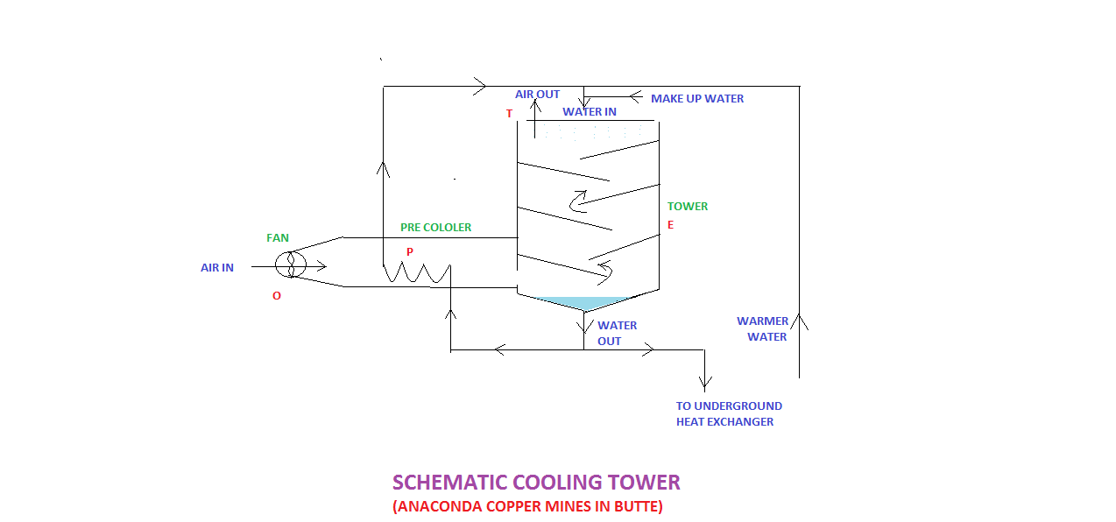

Slide 19
From point O to P the air is pre-cooled before entering the tower. It is then evaporatively cooled from point P to E as it rises in the tower, evaporating some of the spray water and cooling the remainder. This process gradually reaches saturation. With continued, prolonged contact between air and water some sensible heat transfer occur by convection between E and T, the water is further cooled and air heated and humified. The air is discharged, saturated at T.

Slide 20
Cooling tower selection:
It is based on two design limitations , imposed by the first and second law of thermodynamics.
A)The energy lost by the water must be equal to the energy gained by the air, due allowance being made for evaporation.
B) The temperature of the water leaving the tower cannot be less than the wet bulb temperature of the entering air, and the wet-bulb temperature of the air leaving the tower cannot exceed the temperature of entering water.
Air q = Water q
And
GΔh = GwcΔh
C= specific heat of water
Δt temperature difference
In cooling towers water-air ratio, is a useful design parameter.
Gw/G = Δh/cΔt This ratio vries from 0.3 to 3.0
Notes:
G& Gw are weight flow rates Gw/G = water – air ratio.
First Law of Thermo.=states that energy can be transformed (changed from one form to another), but cannot be created or destroyed.\
Second law= stating that the entropy of an isolated system which is not in equilibrium will tend to increase over time, approaching a maximum value at equilibrium ΔQ= TΔS

Slide 21
Two other factors are necessary in specifying cooling tower performance : approach and range
Approach is the difference between the water outlet temperature t0
and the entering air wet-bulb temperature twi ,or
Approach = t0 - twi
It is maintained as low as possible and varies in practice from 2.8 - 6.7°C.
Cooling range is difference between water temperature entering and leaving, or
Range = Δt = ti – to
The usual temperature range of towers is 6.7 – 8.9°C.
Occasionally cooling towers arranged in stages to increase the cooling range.

Slide 22
Cooling Coils
A cooling coil, constructed with metal tubing and fins, is an extended-surface heat exchanger.
Numerous types and styles of coil arrangements and fin styles are used commercially. They are usually arranged in banks, a typical coil standing 18 tubes high and 6 tubes deep, connected to provide 6-36 parallel water circuits.
The relative flow direction of the water and air is probably the most important design consideration in coils. Counter flow is preferred, because it provides the highest possible mean temperature difference.

Slide 23
The driving force for heat transfer is the temperature differences of the two fluids entering and leaving the coil:
q = U A Δtm
q = heat transfer capacity in KW, U = coefficient of heat transfer in W/ m² °C , A = surface area in m² and Δtm = logarithmic mean of temperature difference :
Δtm = (Δt1 – Δt2) / log( t1 / t2 )
Where Δt1 and Δt2 at the two ends of the heat exchanger are identified.

Slide 24
SPRAYS:
In contrast with a coil spray is a direct-contact heat transfer device.It consists of a chamber or enclosure (the walls of the mine opening, if installed underground),a spray nozzle system , a tank a sump for collection of used spary water , and usually an eliminator at the discharge to remove entrained water droplets from air.
Shell and tube heat exchanger:
These are mostly used in chemical plants and oil refineries.

